Slide 1
RDD Operations
INCEPTEZ TECHNOLOGIES

Slide 2
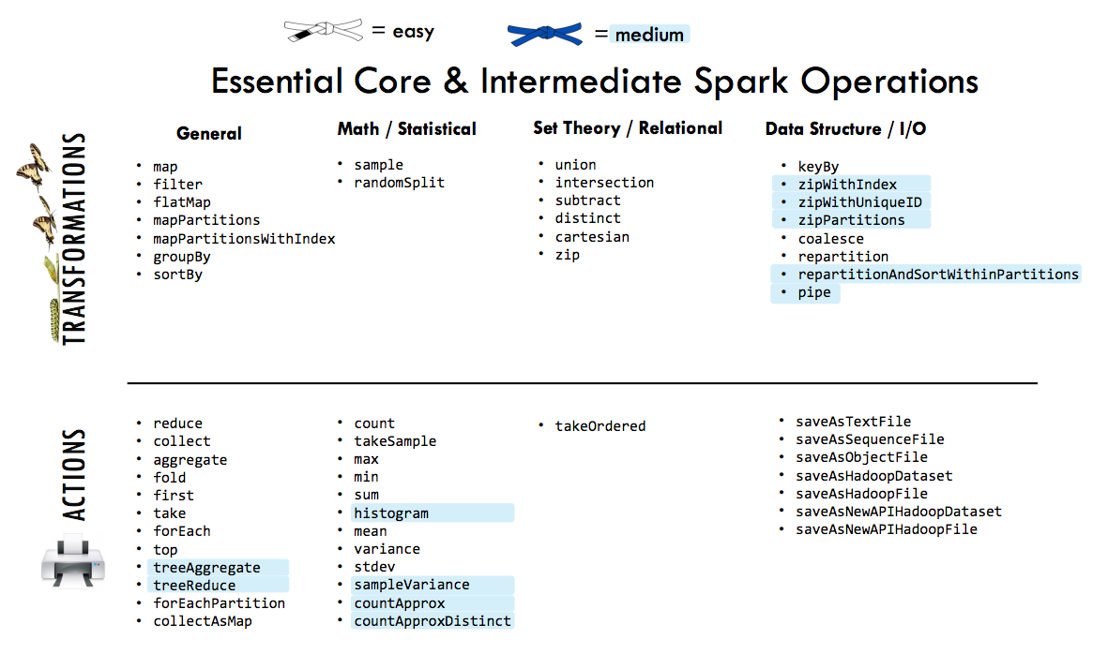
INCEPTEZ TECHNOLOGIES

Slide 3
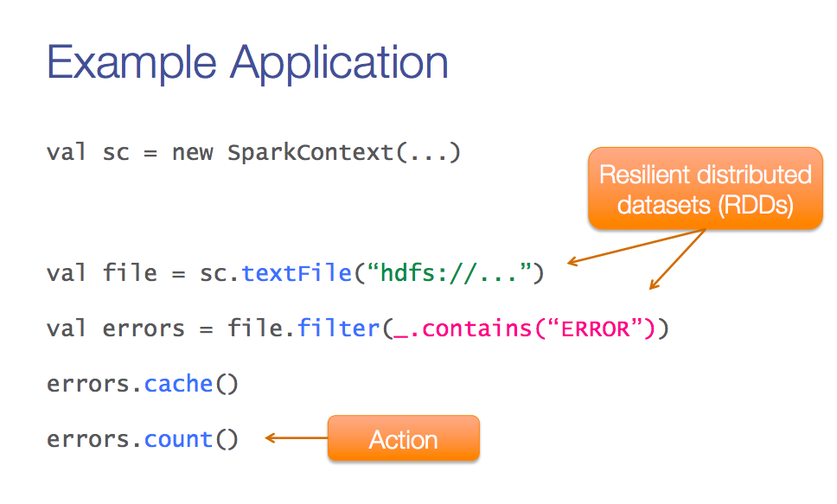
A Sample Application
SparkContext
Transformation
INCEPTEZ TECHNOLOGIES

Slide 4
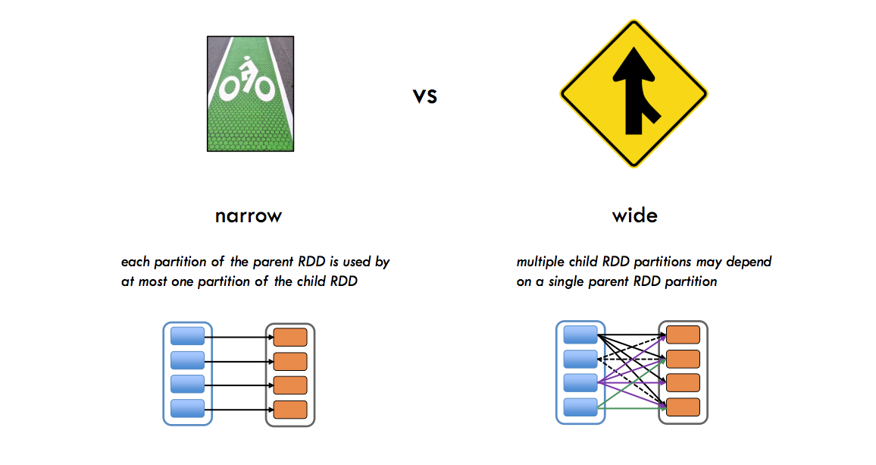
Types of Transformations
INCEPTEZ TECHNOLOGIES

Slide 5
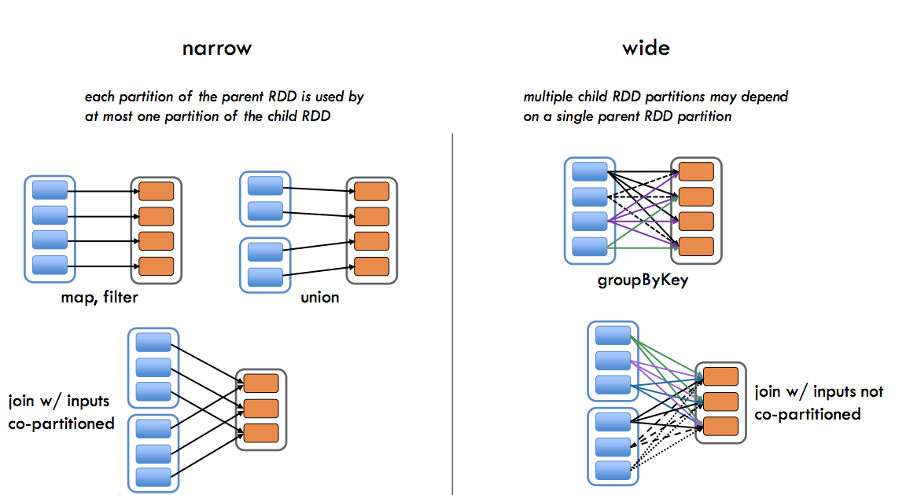
Types of Transformations
INCEPTEZ TECHNOLOGIES

Slide 6
Transformations
INCEPTEZ TECHNOLOGIES

Slide 7
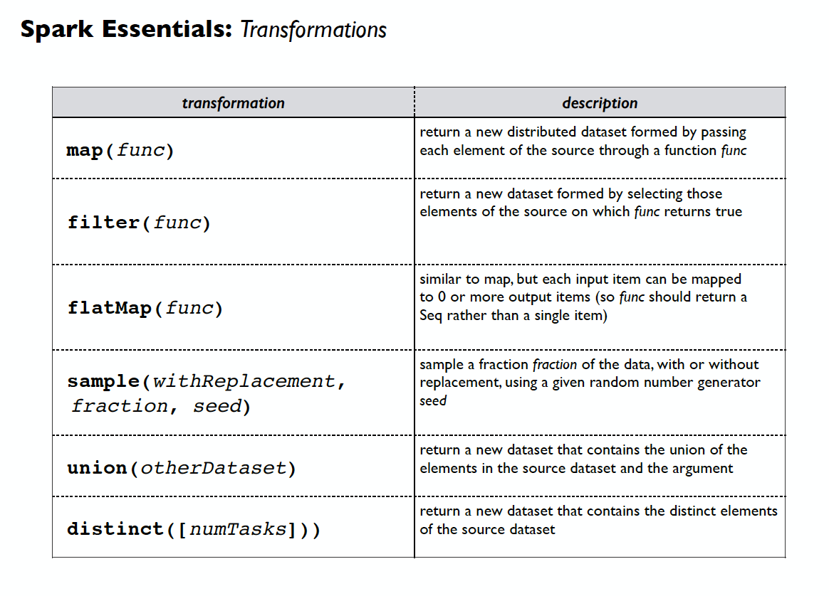
Spark Essentials : Transformations
INCEPTEZ TECHNOLOGIES

Slide 8
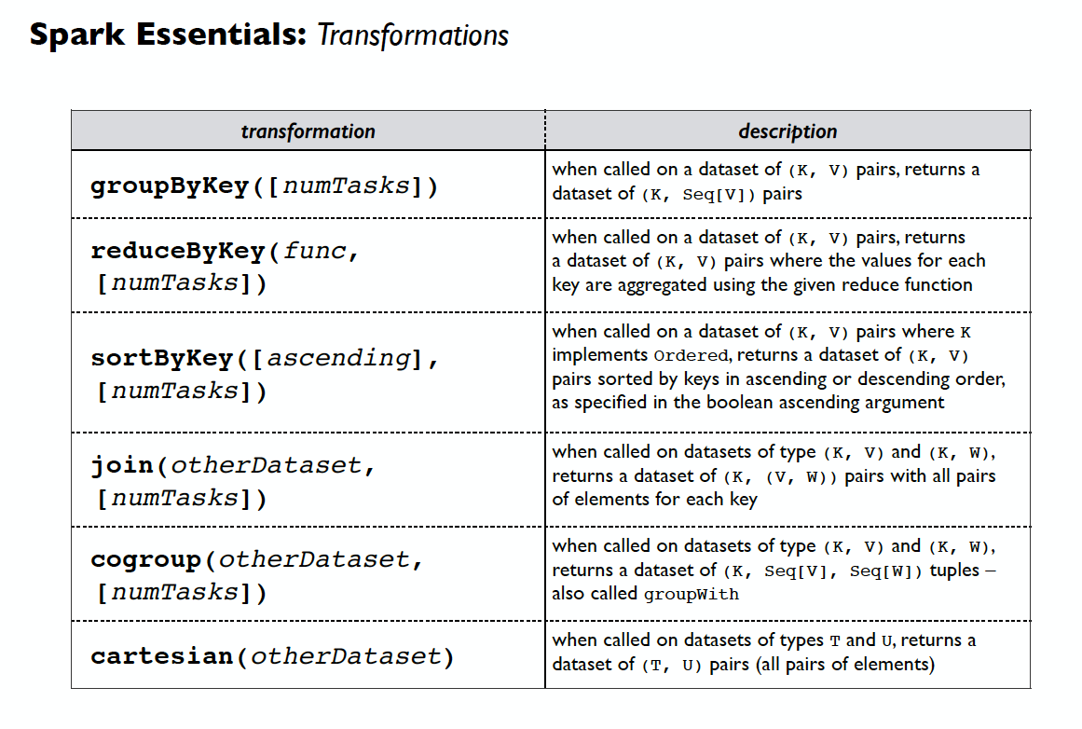
Spark Essentials : Transformations
INCEPTEZ TECHNOLOGIES

Slide 9
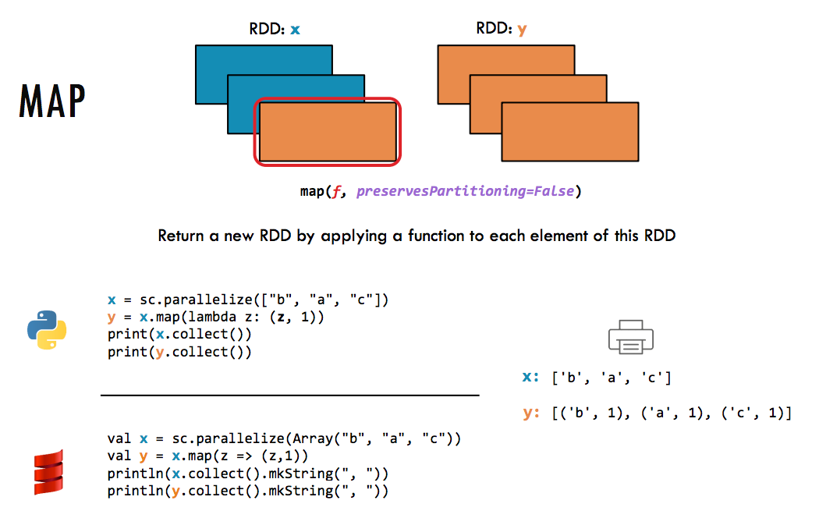
INCEPTEZ TECHNOLOGIES
INCEPTEZ TECHNOLOGIES

Slide 10
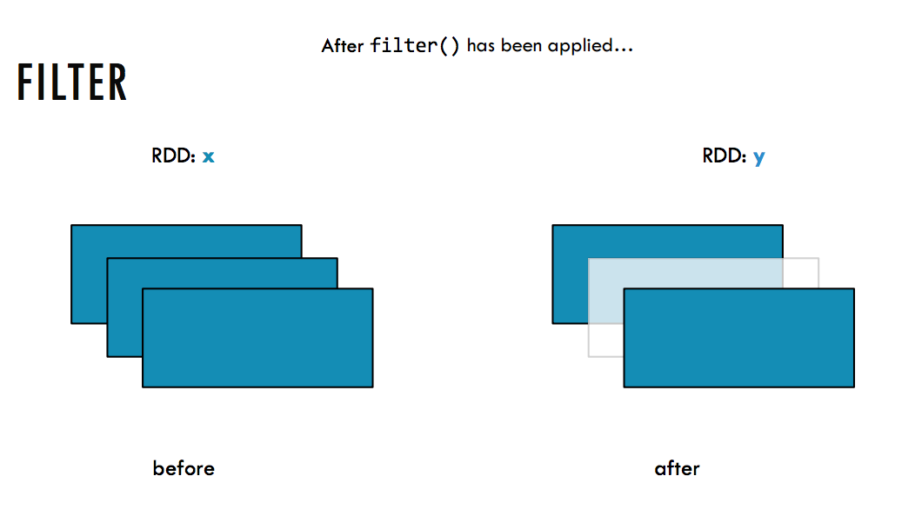
INCEPTEZ TECHNOLOGIES

Slide 11
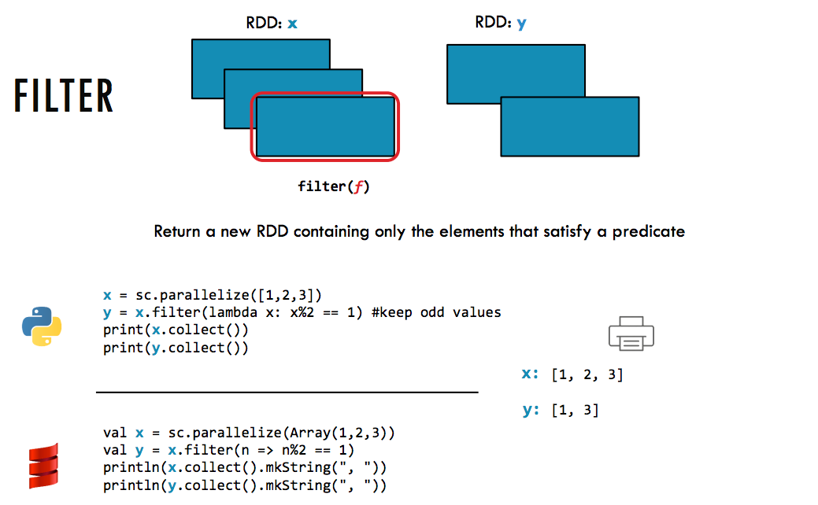
INCEPTEZ TECHNOLOGIES

Slide 12
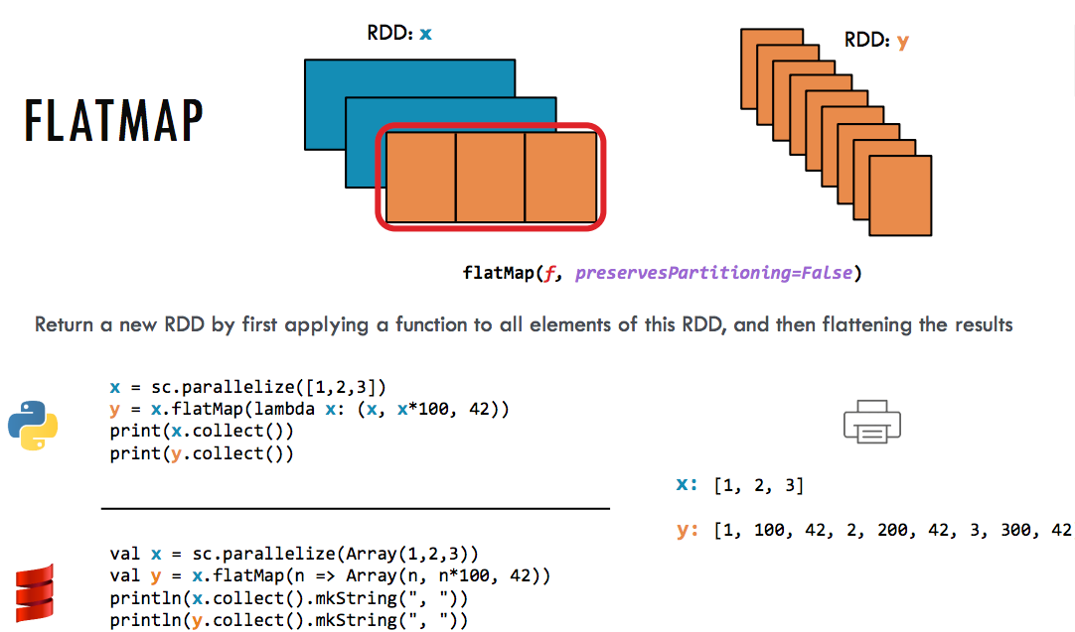
INCEPTEZ TECHNOLOGIES

Slide 13
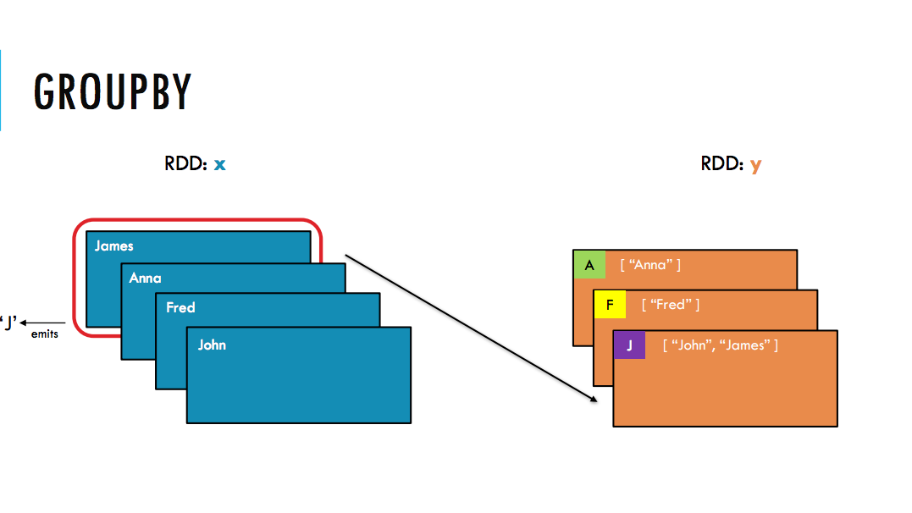
INCEPTEZ TECHNOLOGIES

Slide 14
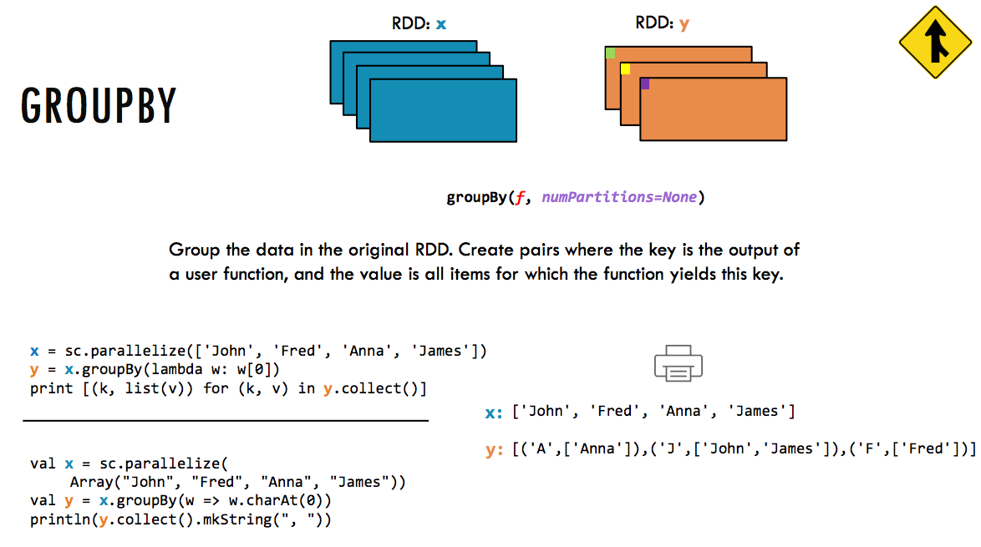
INCEPTEZ TECHNOLOGIES

Slide 15
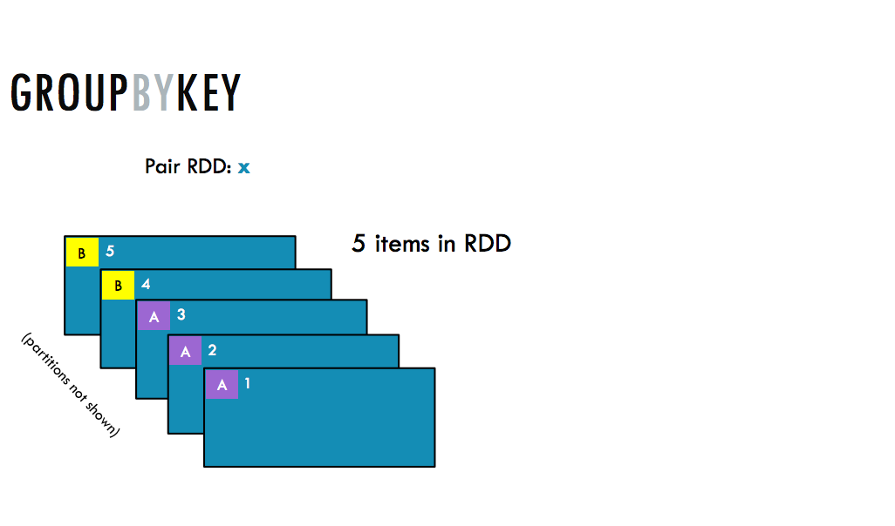
INCEPTEZ TECHNOLOGIES

Slide 16
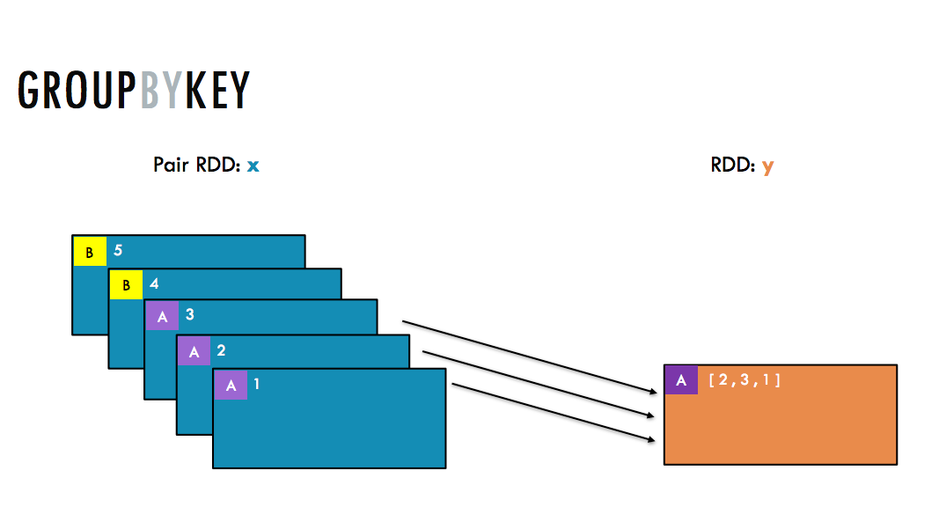
INCEPTEZ TECHNOLOGIES

Slide 17
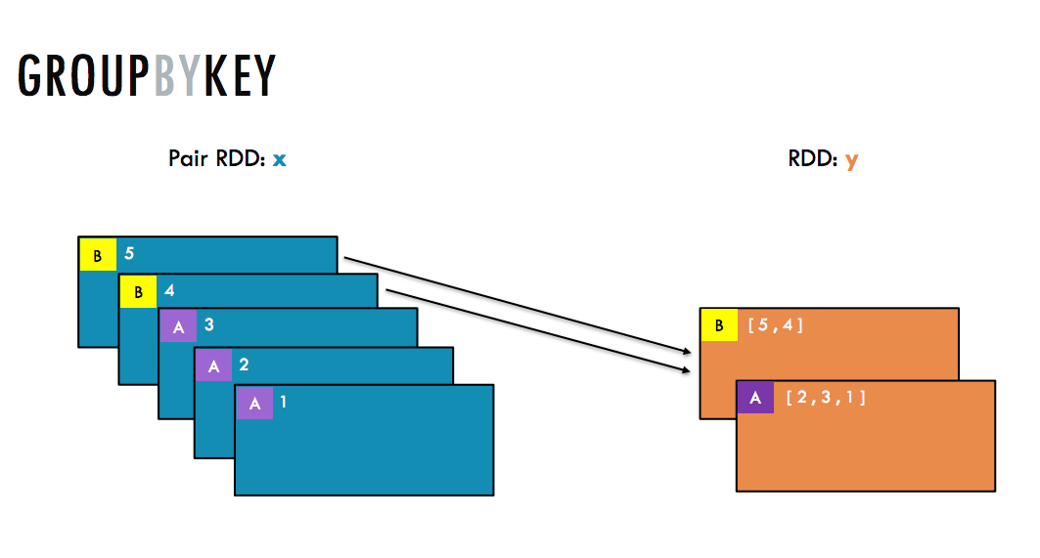
INCEPTEZ TECHNOLOGIES

Slide 18
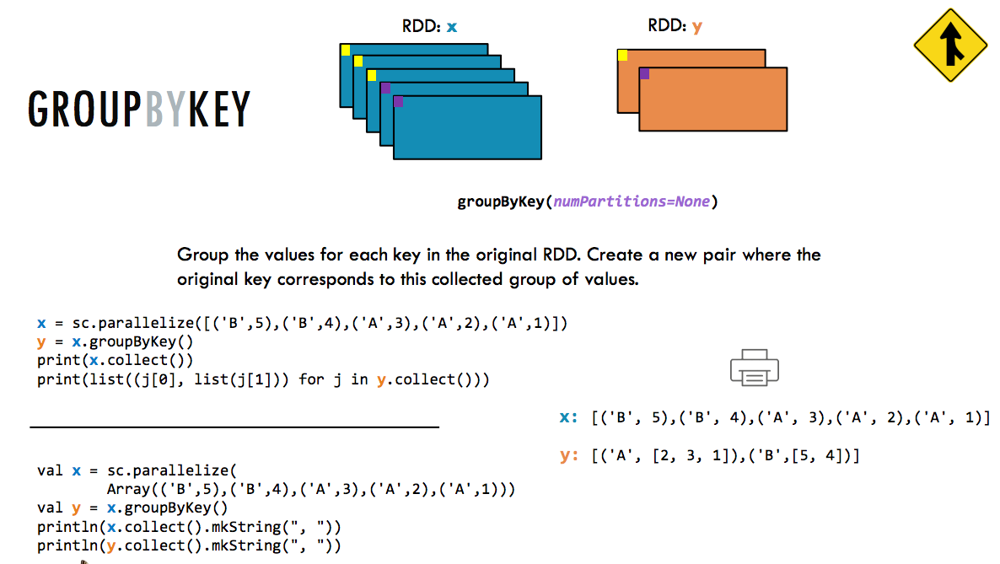
INCEPTEZ TECHNOLOGIES
INCEPTEZ TECHNOLOGIES

Slide 19
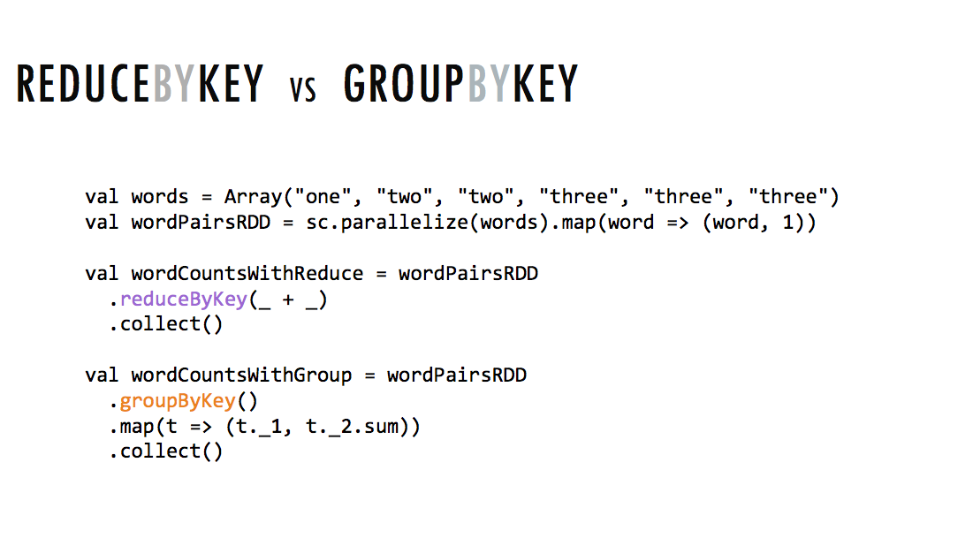

Slide 20
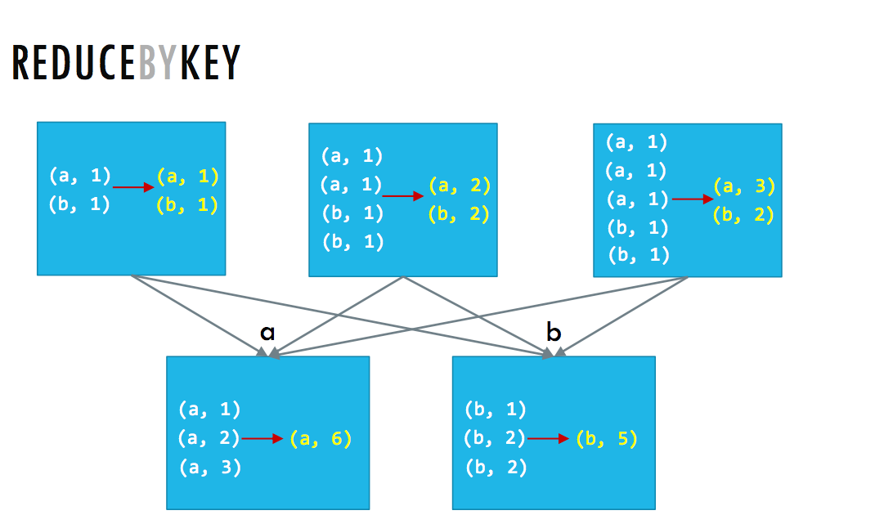
INCEPTEZ TECHNOLOGIES

Slide 21
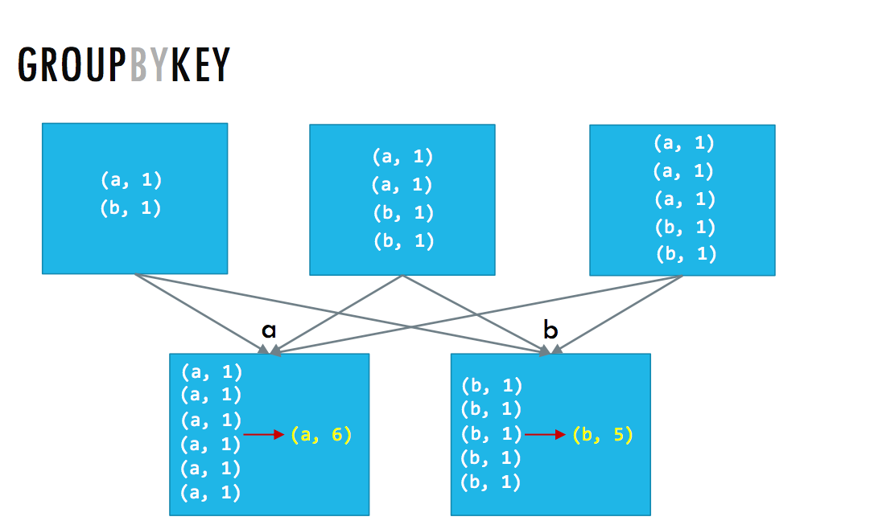
INCEPTEZ TECHNOLOGIES

Slide 22
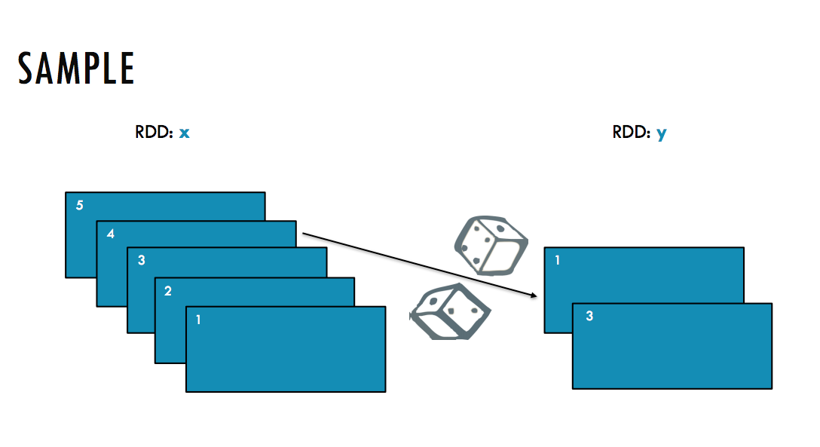

Slide 23
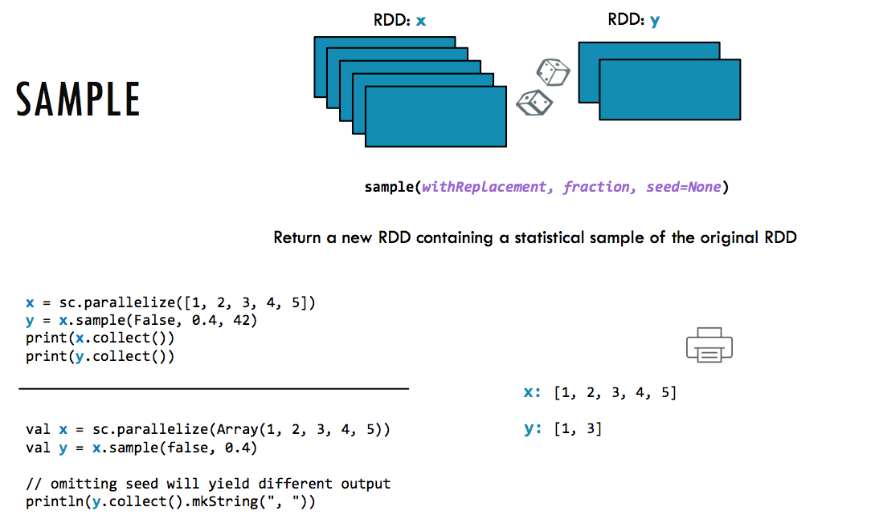
INCEPTEZ TECHNOLOGIES

Slide 24
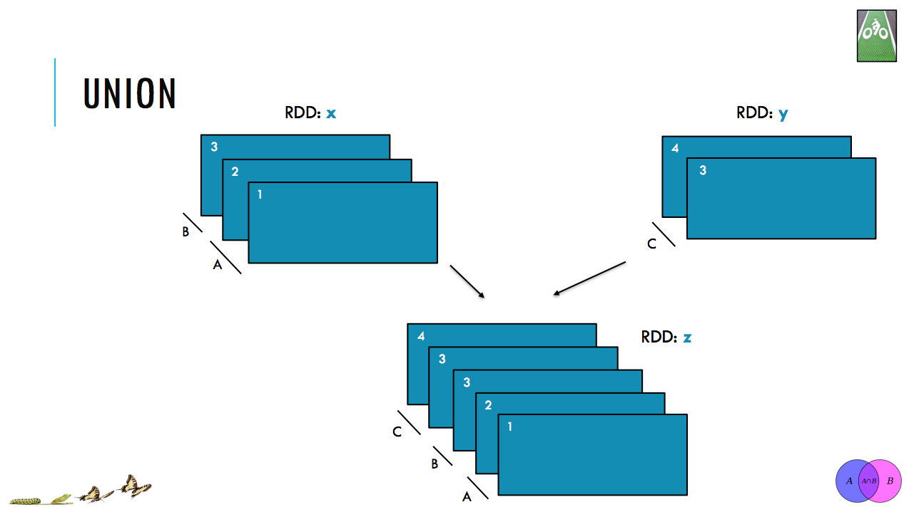
INCEPTEZ TECHNOLOGIES

Slide 25
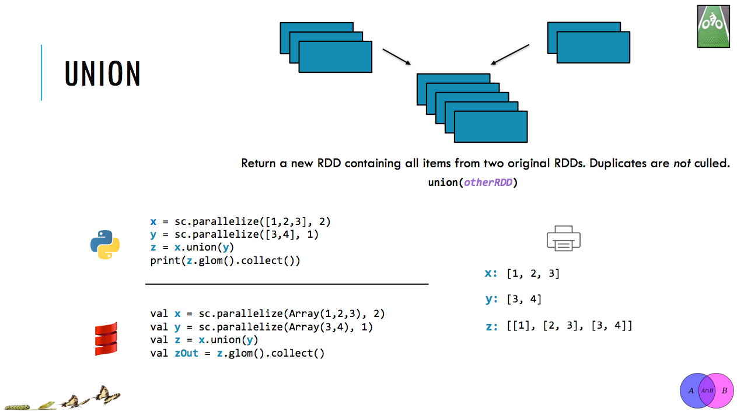
INCEPTEZ TECHNOLOGIES

Slide 26
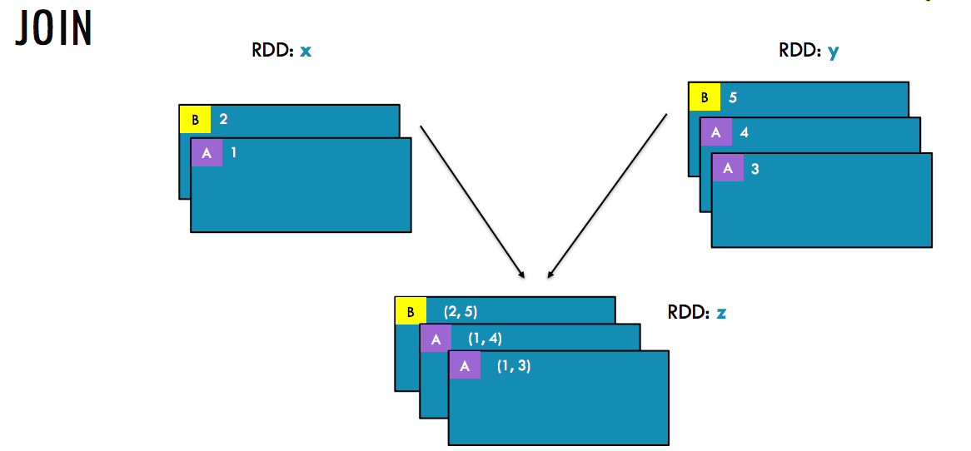
INCEPTEZ TECHNOLOGIES

Slide 27
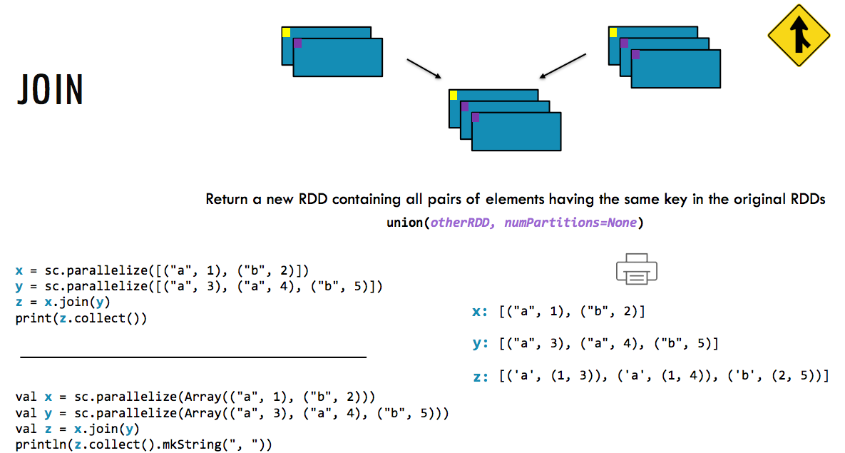
INCEPTEZ TECHNOLOGIES

Slide 28
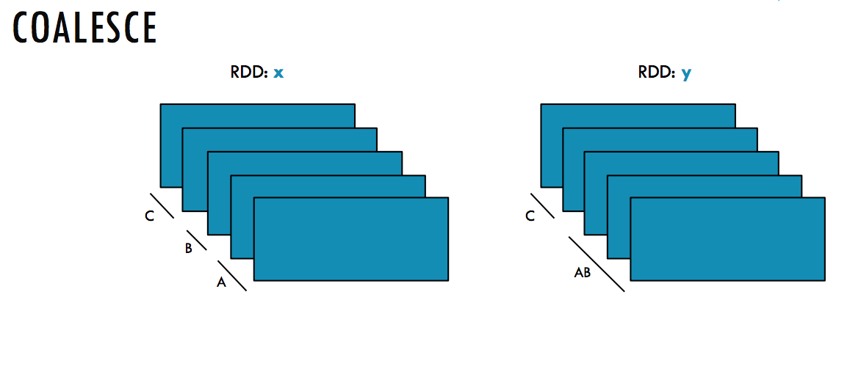
INCEPTEZ TECHNOLOGIES

Slide 29
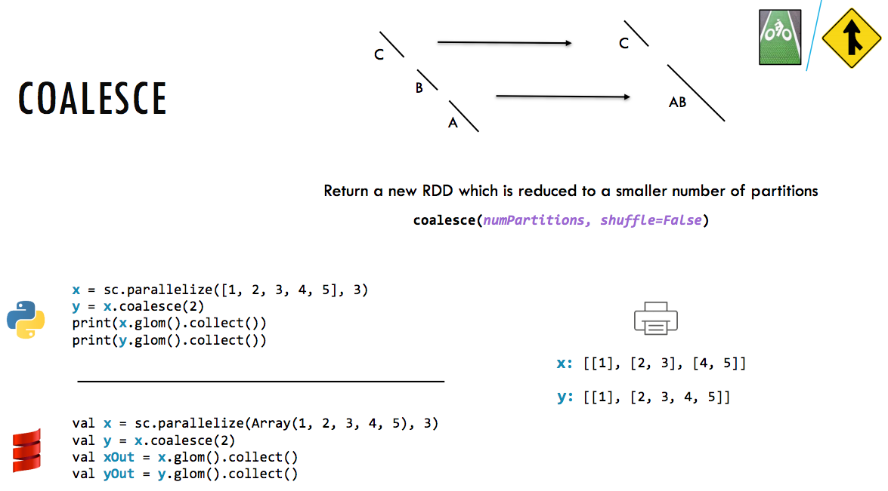
INCEPTEZ TECHNOLOGIES

Slide 30
Actions
INCEPTEZ TECHNOLOGIES

Slide 31
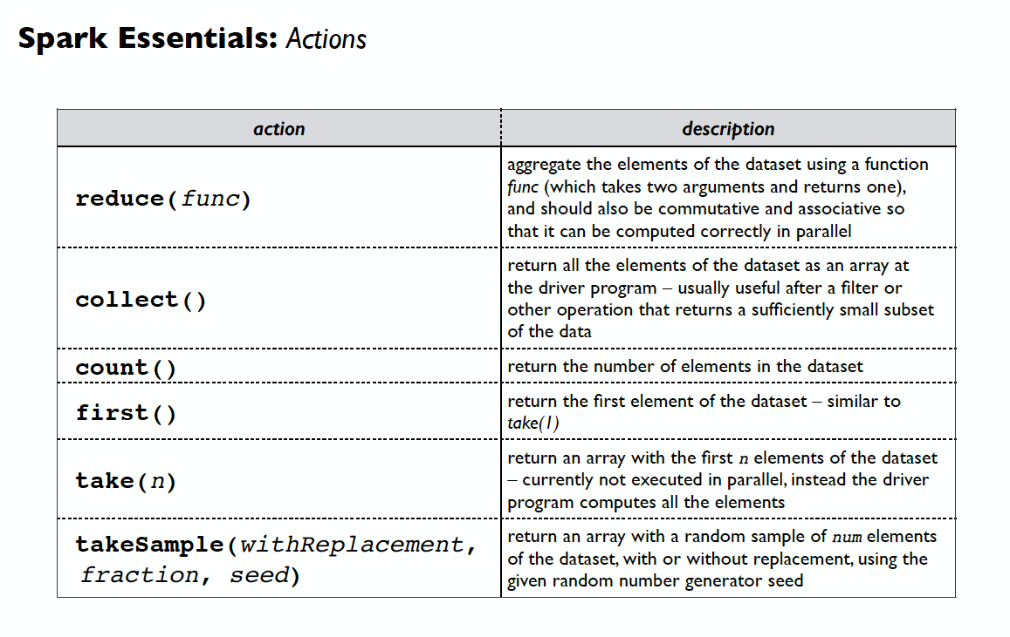
Actions
INCEPTEZ TECHNOLOGIES

Slide 32
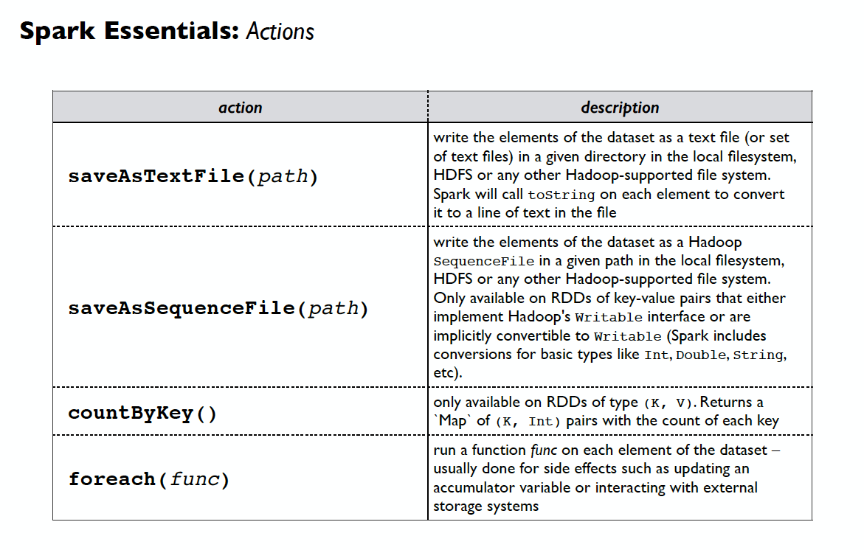
Actions
INCEPTEZ TECHNOLOGIES

Slide 33
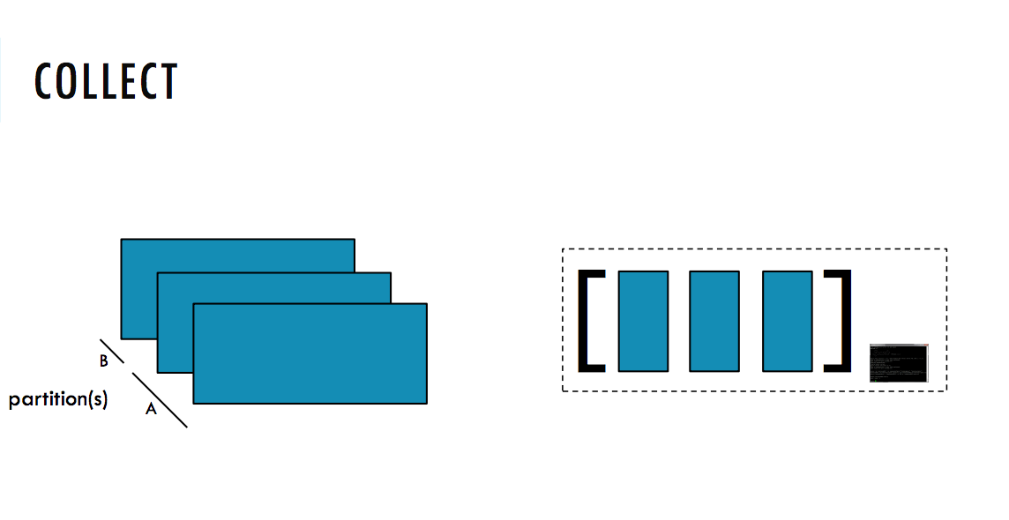
INCEPTEZ TECHNOLOGIES

Slide 34
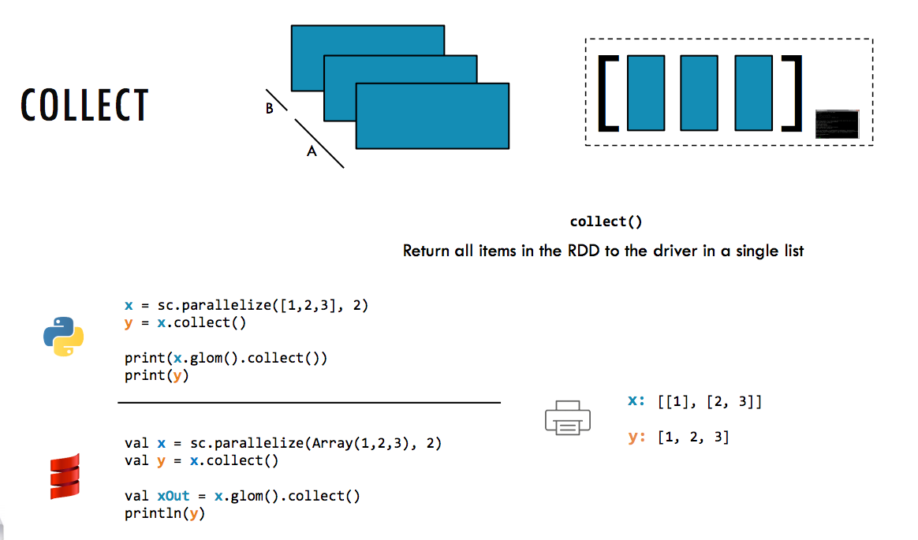
INCEPTEZ TECHNOLOGIES

Slide 35
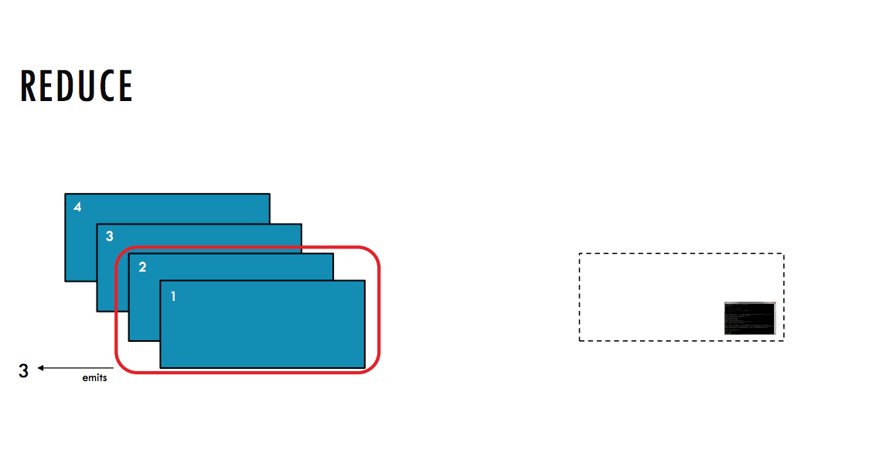
INCEPTEZ TECHNOLOGIES

Slide 36
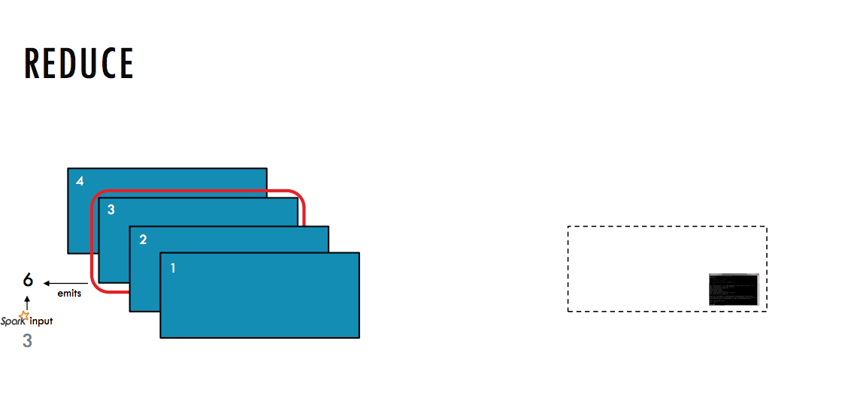
INCEPTEZ TECHNOLOGIES

Slide 37
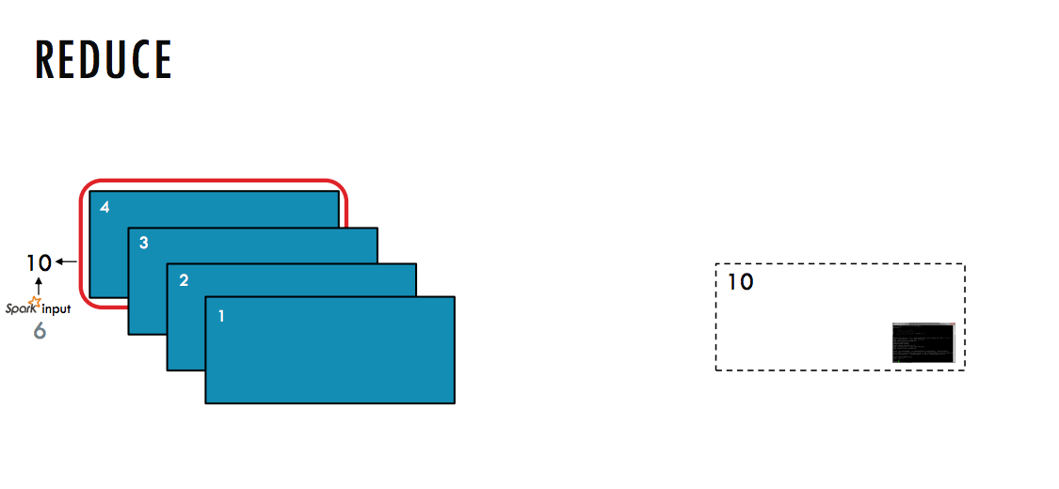
INCEPTEZ TECHNOLOGIES

Slide 38
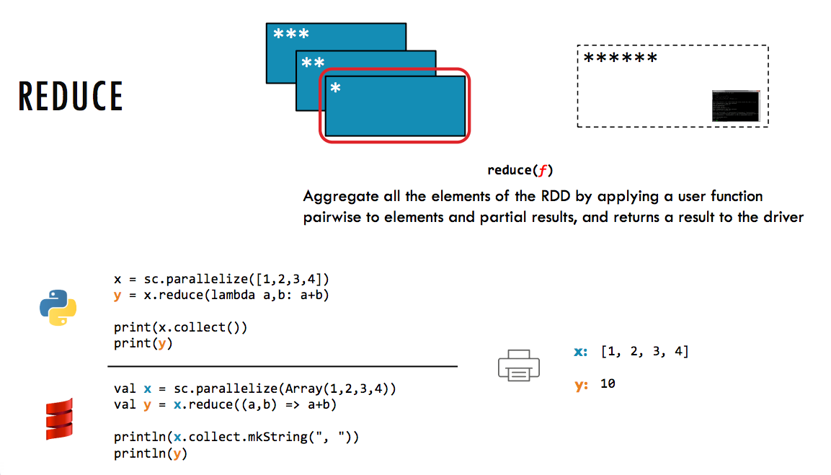
INCEPTEZ TECHNOLOGIES

Slide 39
Interactive Data Analysis with Spark Shell
INCEPTEZ TECHNOLOGIES

Slide 40
INCEPTEZ TECHNOLOGIES

Slide 41
Caching and Persistence
INCEPTEZ TECHNOLOGIES

Slide 42
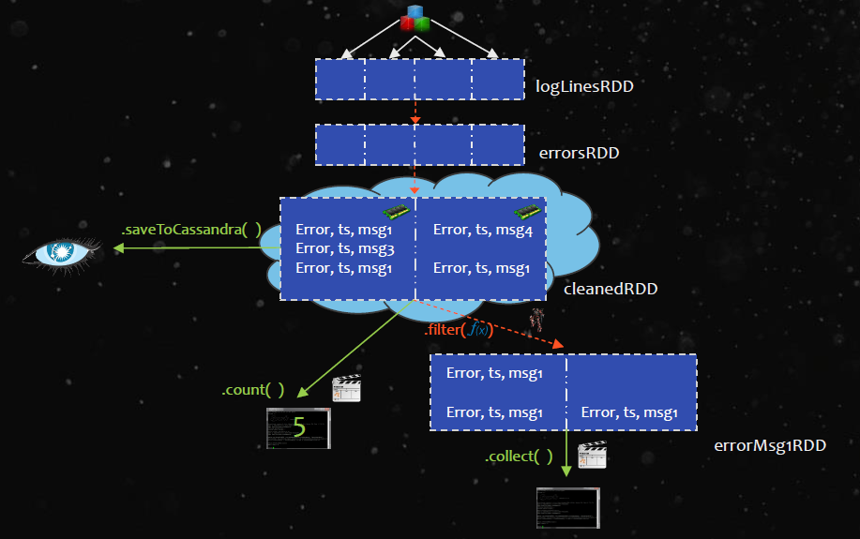
Why Caching
INCEPTEZ TECHNOLOGIES

Slide 43
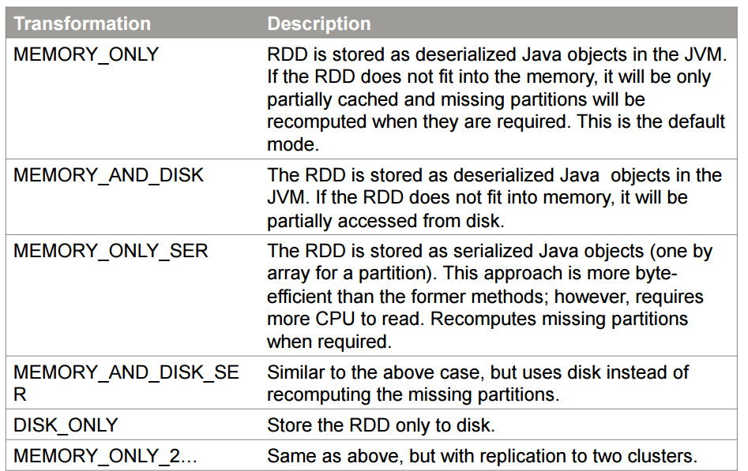
Persistence Levels
INCEPTEZ TECHNOLOGIES

Slide 44
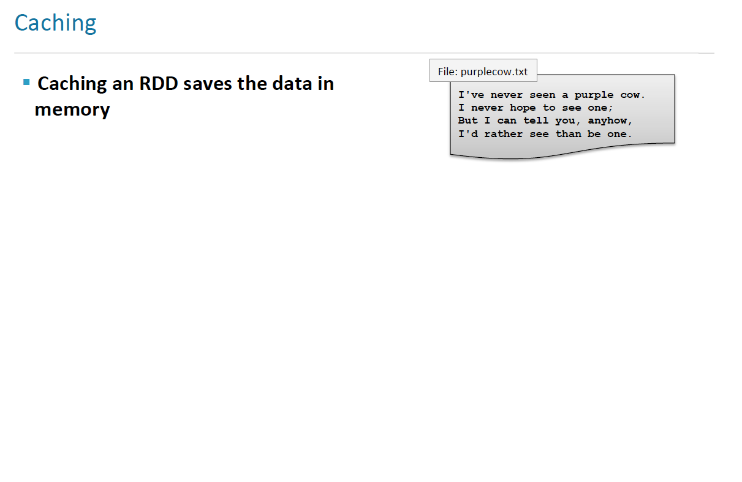
INCEPTEZ TECHNOLOGIES

Slide 45
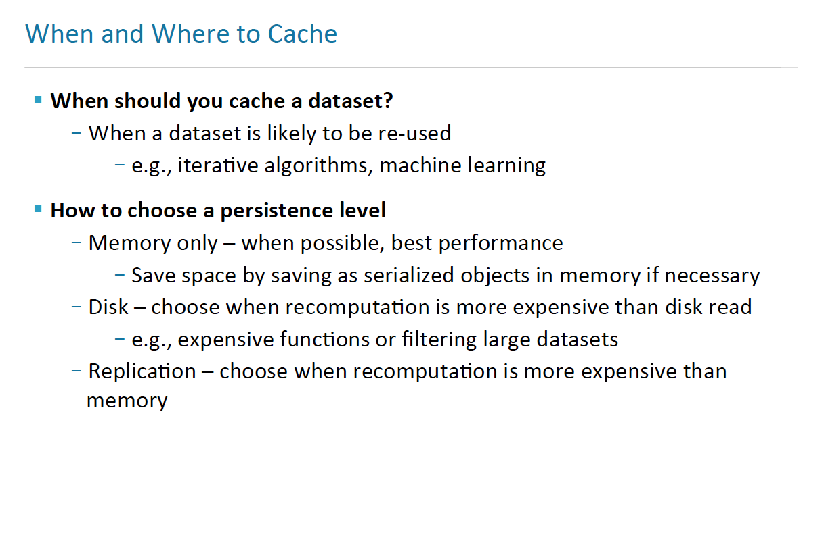
INCEPTEZ TECHNOLOGIES

Slide 46
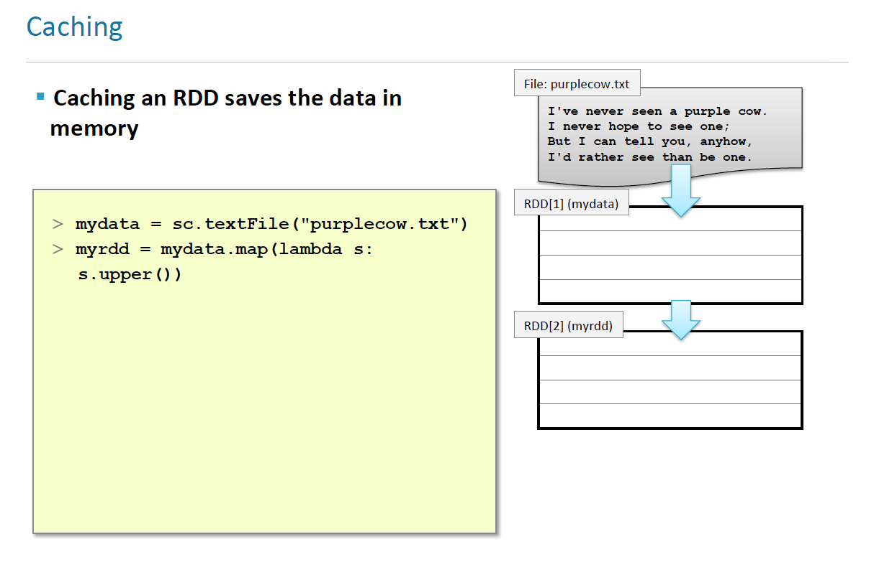
INCEPTEZ TECHNOLOGIES

Slide 47
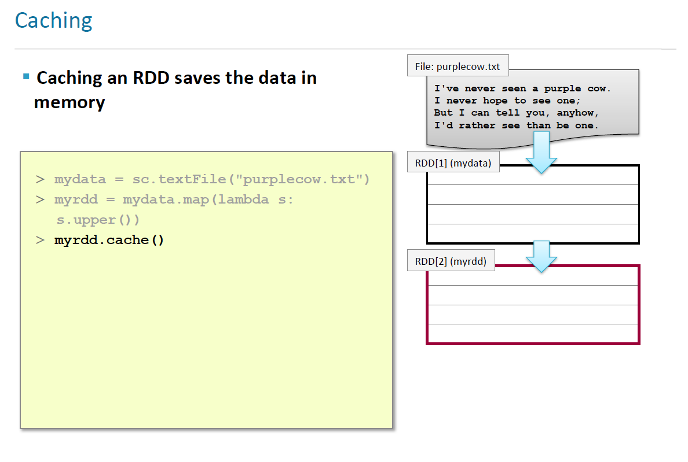
INCEPTEZ TECHNOLOGIES

Slide 48
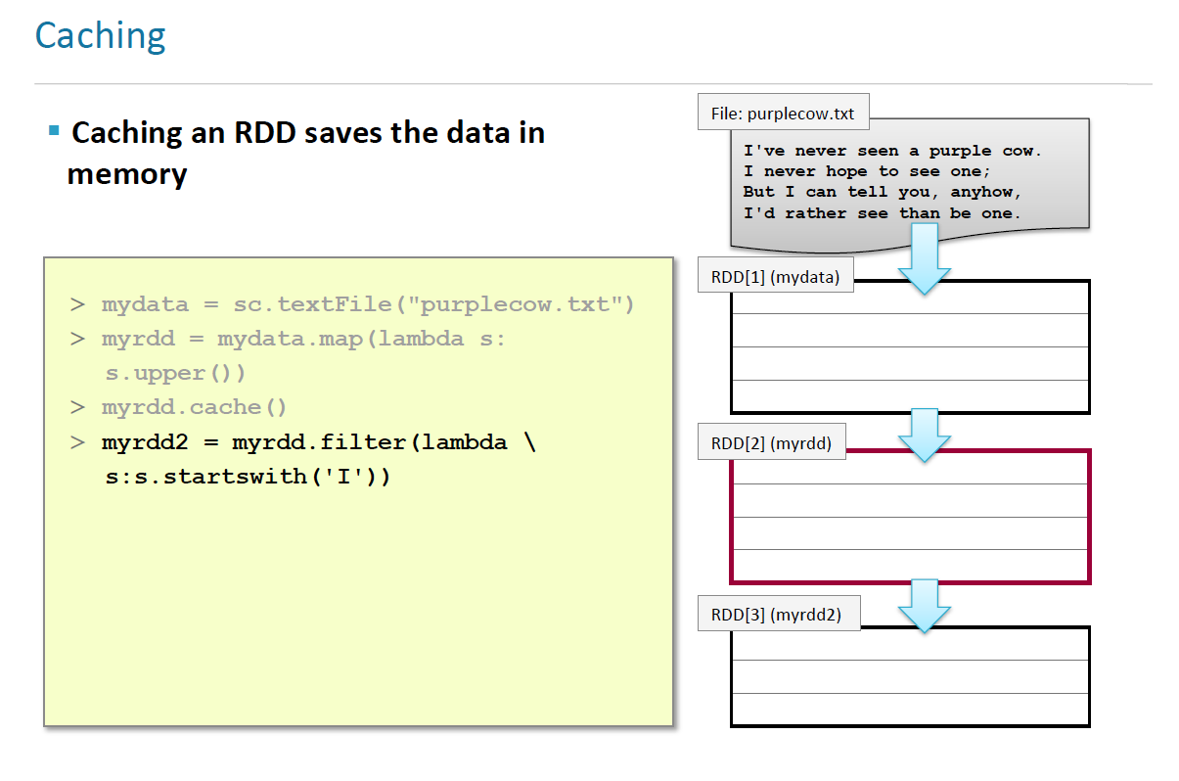
INCEPTEZ TECHNOLOGIES

Slide 49
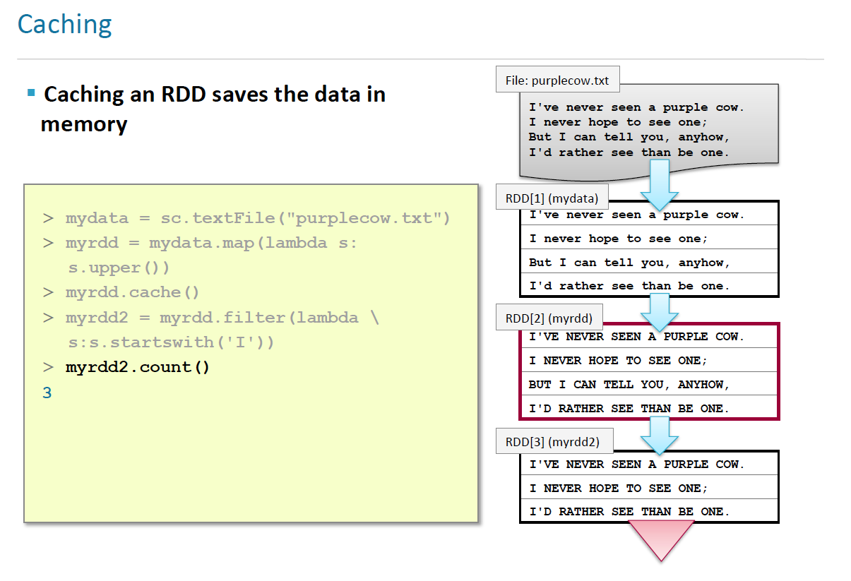
INCEPTEZ TECHNOLOGIES

Slide 50
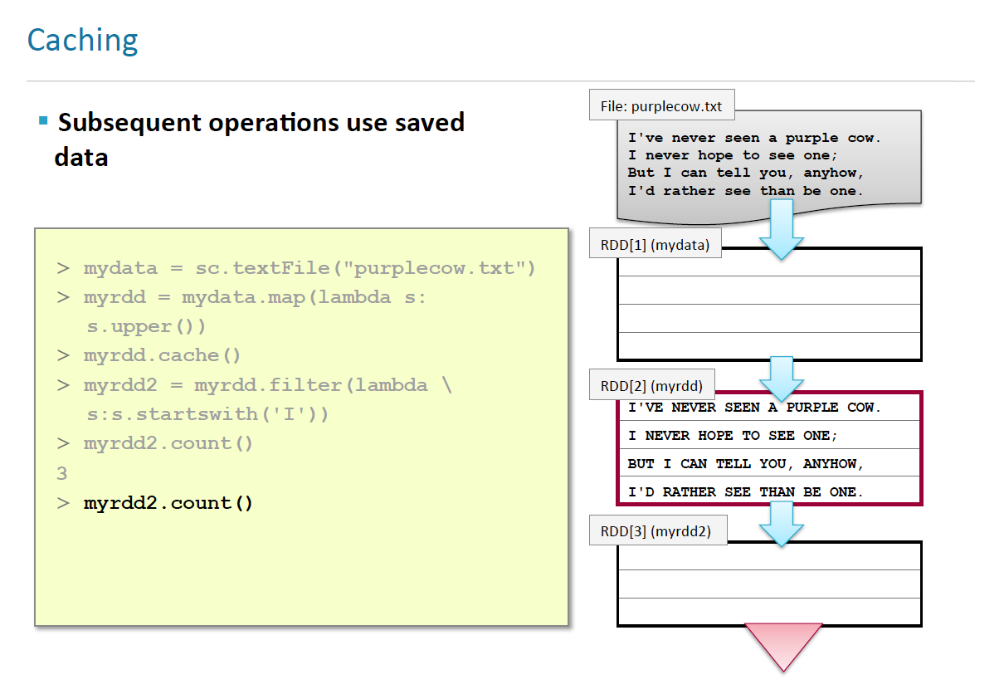
INCEPTEZ TECHNOLOGIES

Slide 51
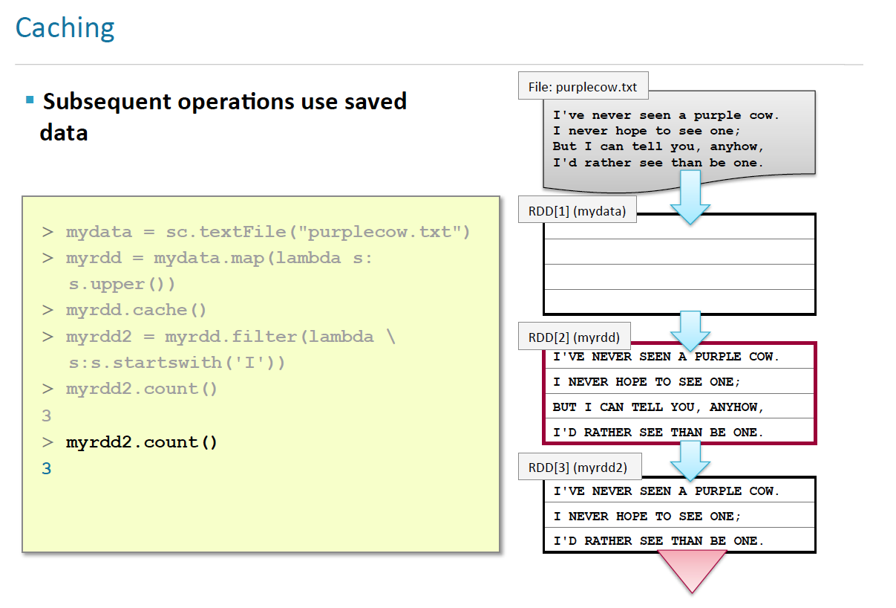
INCEPTEZ TECHNOLOGIES

Slide 52
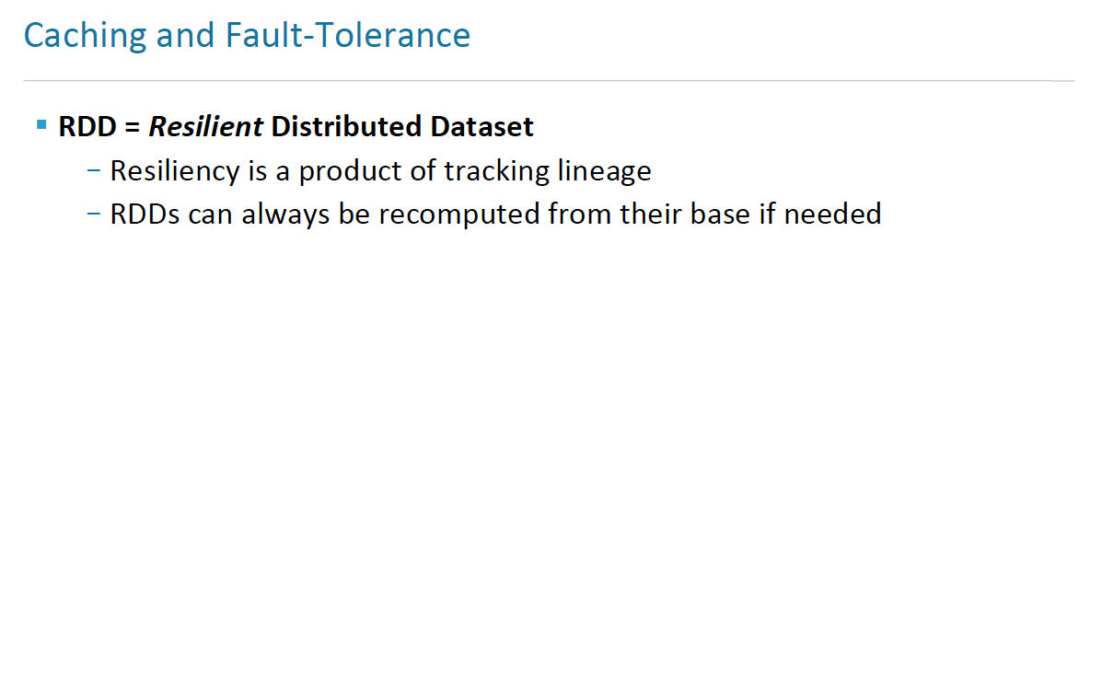
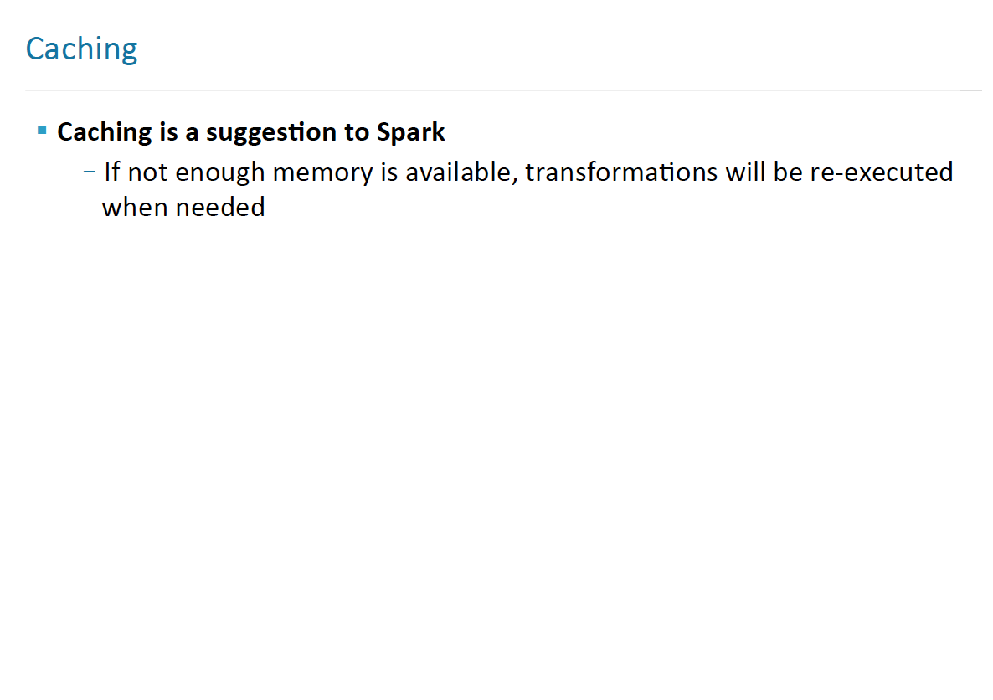
INCEPTEZ TECHNOLOGIES

Slide 53
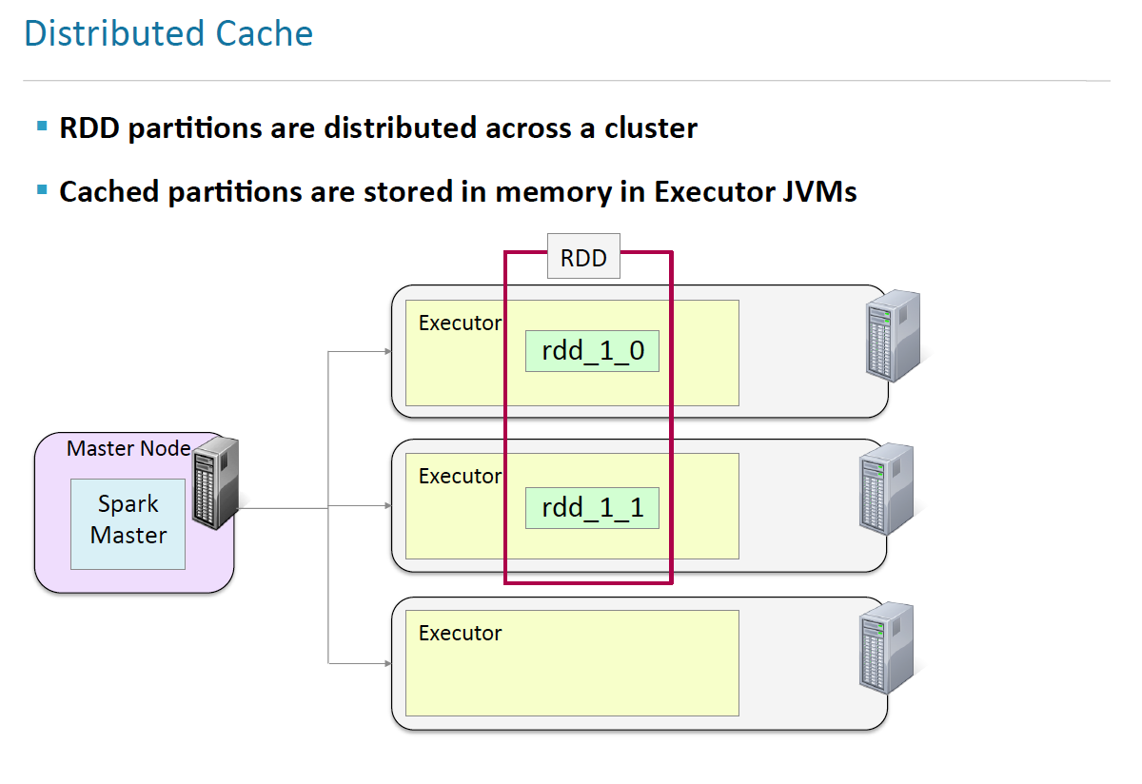
INCEPTEZ TECHNOLOGIES

Slide 54
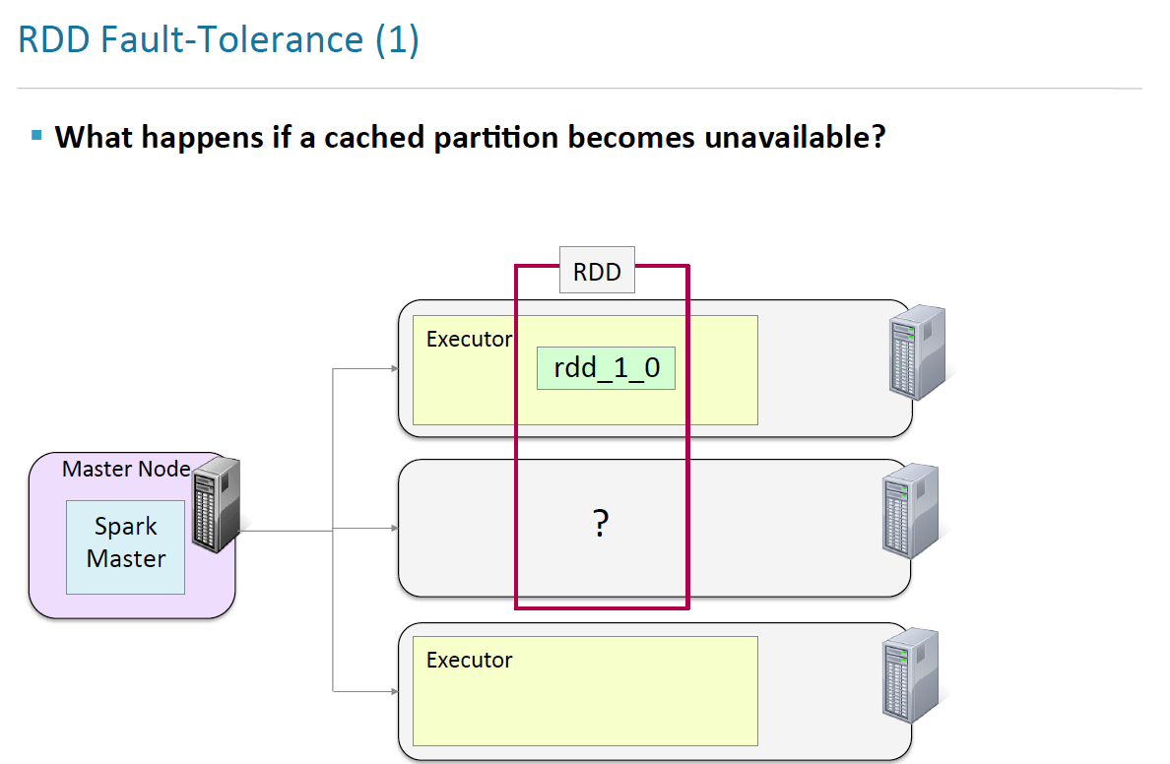
INCEPTEZ TECHNOLOGIES

Slide 55
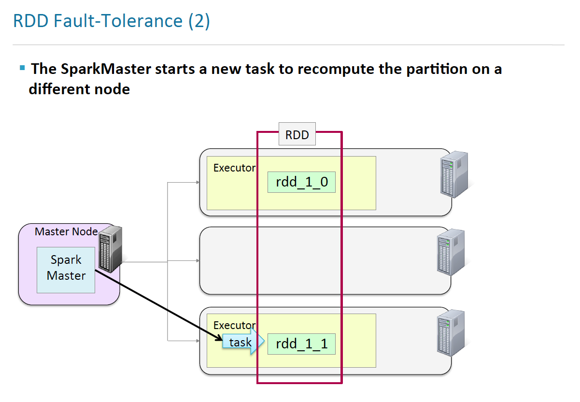
INCEPTEZ TECHNOLOGIES

Slide 56

INCEPTEZ TECHNOLOGIES

Slide 57

INCEPTEZ TECHNOLOGIES

Slide 58

INCEPTEZ TECHNOLOGIES

Slide 59

INCEPTEZ TECHNOLOGIES

Slide 60

INCEPTEZ TECHNOLOGIES

Slide 61

INCEPTEZ TECHNOLOGIES

Slide 62

INCEPTEZ TECHNOLOGIES

Slide 63

INCEPTEZ TECHNOLOGIES

Slide 64
Demo
INCEPTEZ TECHNOLOGIES

Slide 65
Transformations & Actions
Demo
INCEPTEZ TECHNOLOGIES

Slide 66
Tuning and Debugging in Apache Spark
INCEPTEZ TECHNOLOGIES

Slide 67


Key Question
How does a user program get translated into units of physical execution: jobs, stages, and tasks:
?

Slide 68

Spark Application
INCEPTEZ TECHNOLOGIES

Slide 69

Job Scheduling Process
INCEPTEZ TECHNOLOGIES

Slide 70

DAG Scheduler
INCEPTEZ TECHNOLOGIES

Slide 71

Scheduler Optimizations
INCEPTEZ TECHNOLOGIES

Slide 72

Task
INCEPTEZ TECHNOLOGIES

Slide 73

Shuffle
INCEPTEZ TECHNOLOGIES

Slide 74

Shuffle
INCEPTEZ TECHNOLOGIES

Slide 75

RDD API Example
951
916
INCEPTEZ TECHNOLOGIES

